Slide 1

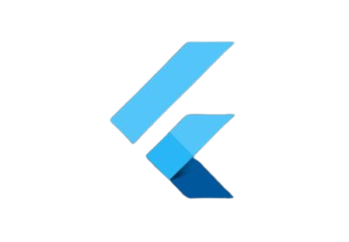
Advanced UI Development Techniques: Mastering the Art of Engaging and Scalable Interfaces
Unleashing the Power of Custom Widgets, Complex Layouts, Animations, State Management, and Backend Integration
Notes:
Hello everyone, welcome to our session on "Advanced UI Development Techniques”,In this presentation we will delve into the world of Advanced UI Development Techniques : Mastering the Art of Engaging and Scalable Interfaces.We'll cover
Advanced widget usage, Custom widget, Complex widgets, Responsive Design, Advanced animations and Motion Design, short description of State management and Integrating UI with Backend services.

Slide 2
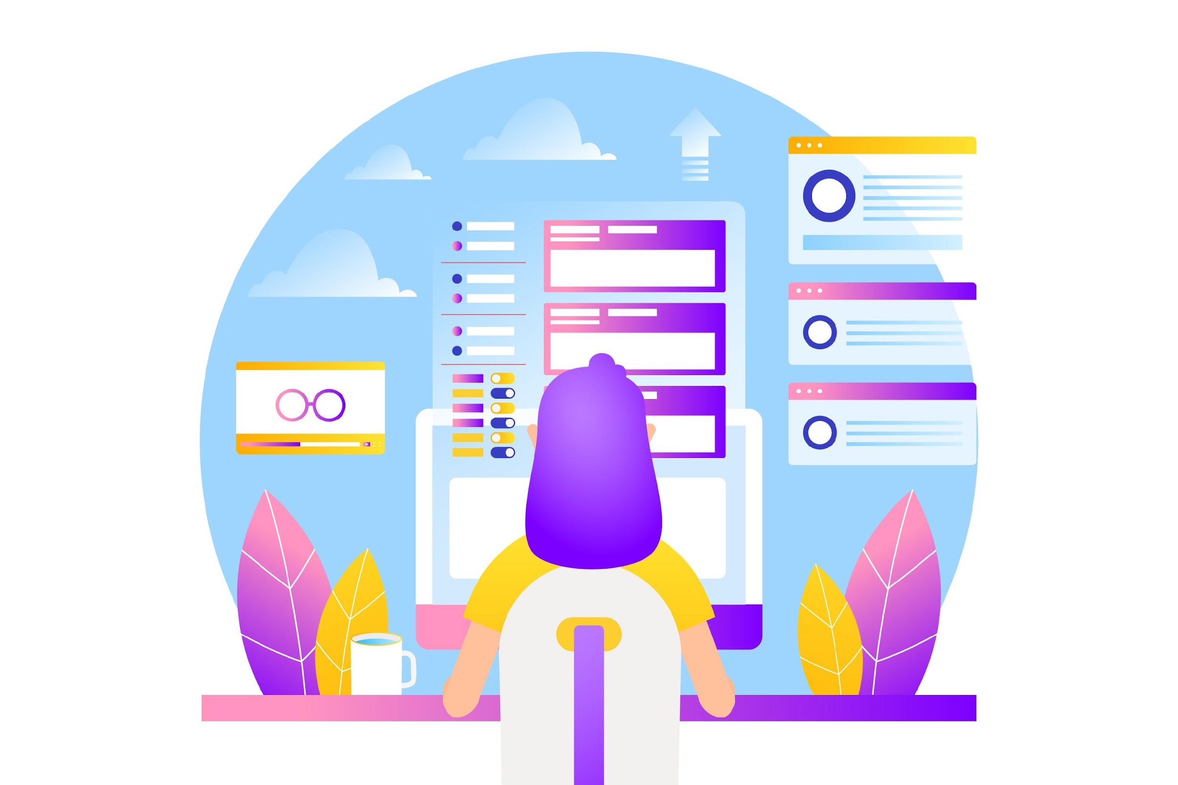

Introduction
Modern UI Challenge:
Develop visually appealing, functional, scalable, and maintainable user interfaces across diverse platforms and devices.​
​
Advanced Techniques Requirement:
Master advanced UI development techniques to overcome challenges and create exceptional user experiences.​
​
​
Notes:
UI design in Flutter involves utilizing its framework and tools to create visually appealing and user-friendly interfaces for mobile applications.
Modern UI Challenge: Develop visually appealing, functional, scalable, and maintainable user interfaces across diverse platforms and devices.​
​
Advanced Techniques Requirement: Master advanced UI development techniques to overcome challenges and create exceptional user experiences.​

Slide 3

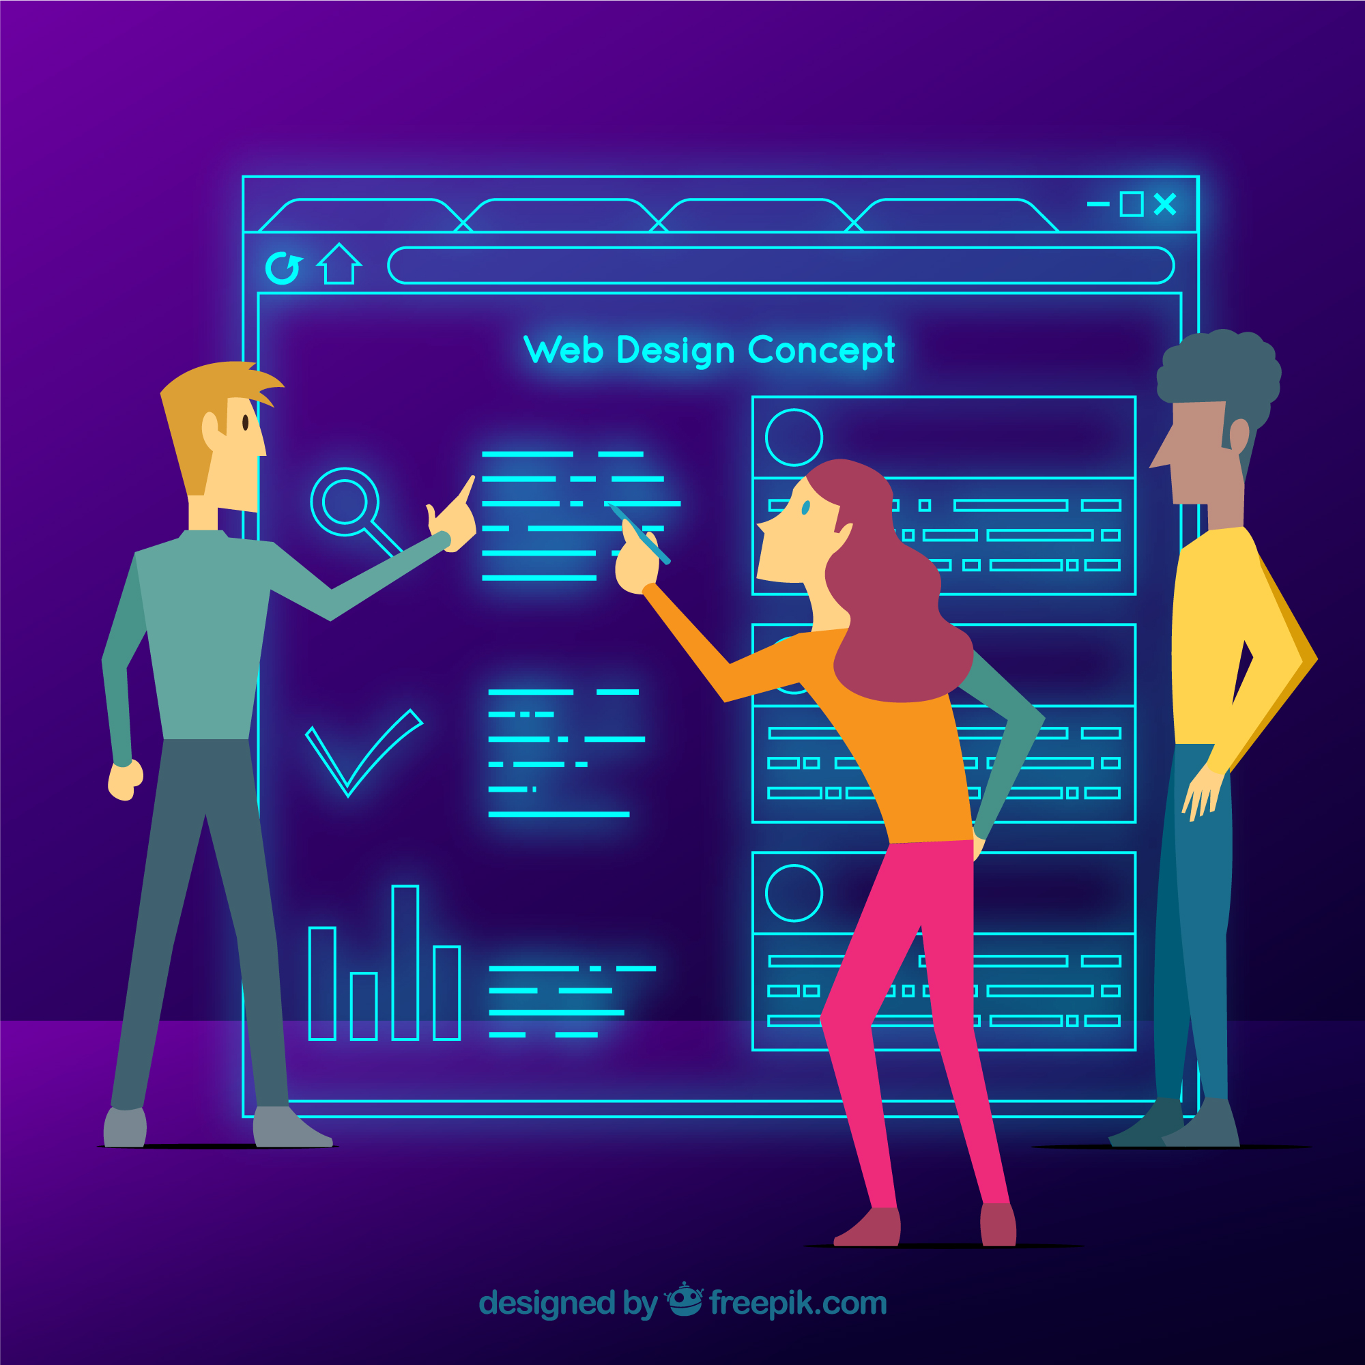
Advanced Widget Usage
Harnessing the Full Potential of Built-in Widgets​
Creating Custom Widgets for Specific Needs​
Leveraging Widget Libraries and Frameworks​
Notes:
Harnessing the Full Potential of Built-in Widgets: Unleashing the hidden capabilities of existing widgets to achieve sophisticated UI elements
Creating Custom Widgets for Specific Needs: Designing reusable and customizable widgets to encapsulate UI logic and styling, enhancing maintainability and consistency
Leveraging Widget Libraries and Frameworks: Utilizing pre-built widget libraries and frameworks to streamline development and access a wealth of UI components

Slide 4
Built-in Widgets
ListView:​
Displays items in a one-dimensional layout: either vertically (default) or horizontally.​
Useful for lists of text, images, cards, or any content that follows a linear order.​
Offers various constructors for different scenarios:​
ListView.builder for dynamically generating items from a data source.​
ListView.separated for adding separators between items.​
ListView.custom for full control over layout and scrolling.​
Notes:
ListView:​
Displays items in a one-dimensional layout: either vertically (default) or horizontally.​
Useful for lists of text, images, cards, or any content that follows a linear order.​
Offers various constructors for different scenarios:​
ListView.builder for dynamically generating items from a data source.​
ListView.separated for adding separators between items.​
ListView.custom for full control over layout and scrolling.​

Slide 5
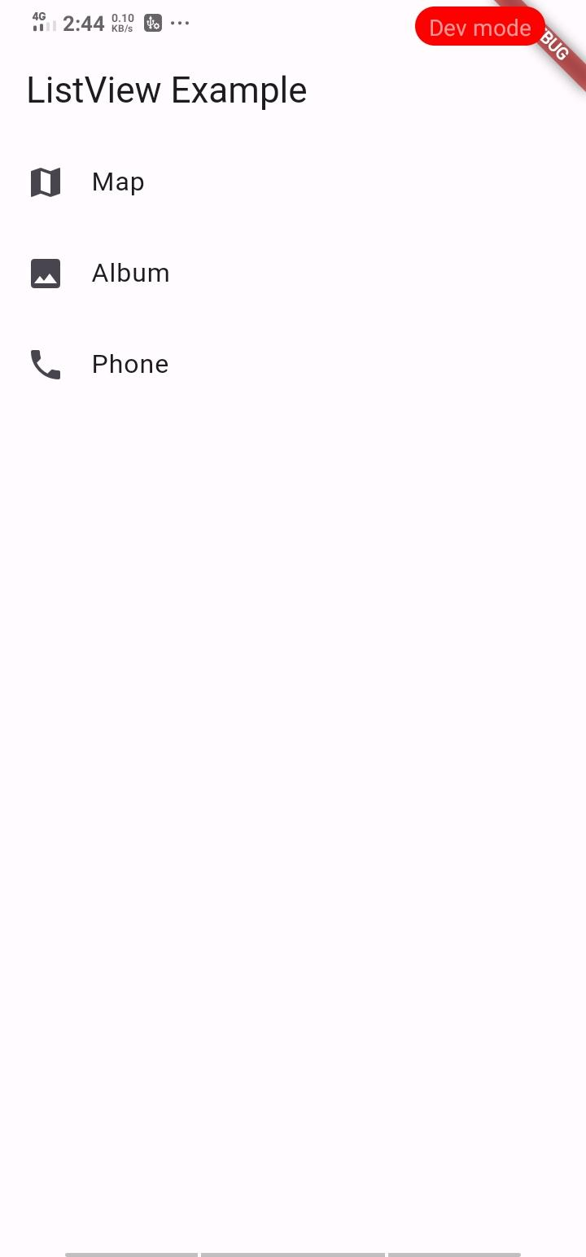
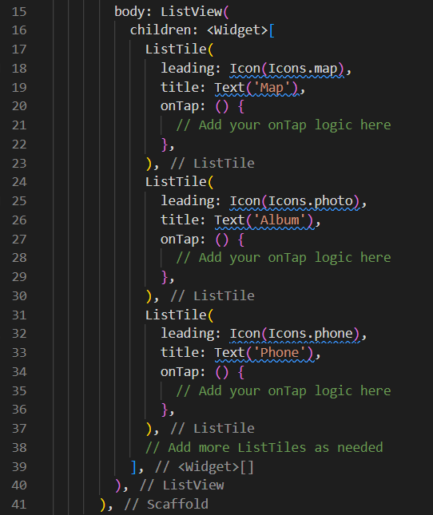
Example of List view
Output:​

Slide 6
Grid View:
Grid View:
Arranges items in a two-dimensional grid layout: rows and columns.
Suitable for photo galleries, product catalogs, or any visually oriented data.
Includes constructors for defining the number of items per row/column and spacing between them.
GridView.count specifies the number of items in each row or column.
GridView.builder similar to List View. builder but arranges items in a grid.
GridView.extent uses a fixed size for each item.
Notes:
Grid View:
Arranges items in a two-dimensional grid layout: rows and columns.
Suitable for photo galleries, product catalogs, or any visually oriented data.
Includes constructors for defining the number of items per row/column and spacing between them.
GridView.count specifies the number of items in each row or column.
GridView.builder similar to List View. builder but arranges items in a grid.
GridView.extent uses a fixed size for each item.

Slide 7
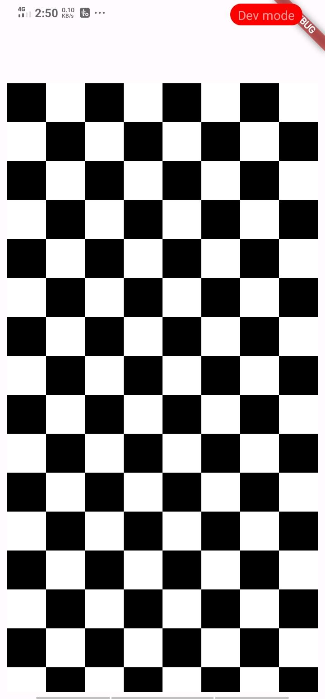
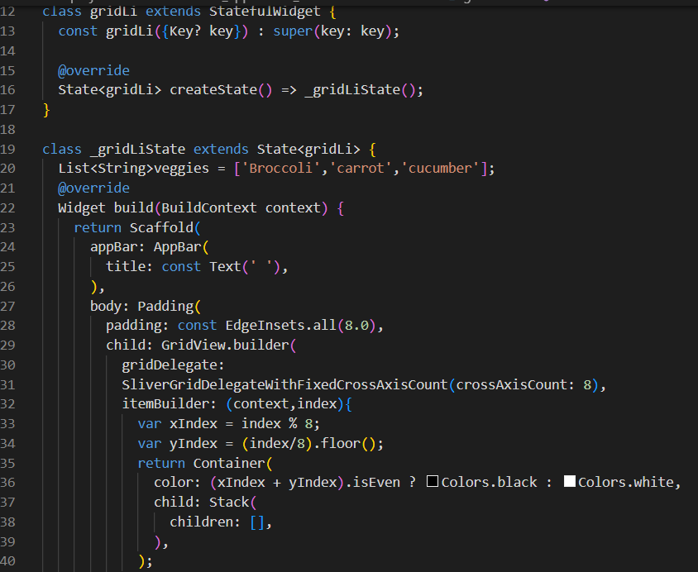
Example of Gid view
Output:​

Slide 8
Tab Bar
Working with tabs is a common pattern in apps that follow the Material Design guidelines.
Flutter includes a convenient way to create tab layouts as part of the material library.​
This recipe creates a tabbed example using the following steps:
Create a Tab Controller.​
Create the tabs.​
Create content for each tab.​
Notes:
Working with tabs is a common pattern in apps that follow the Material Design guidelines.
Flutter includes a convenient way to create tab layouts as part of the material library.​
This recipe creates a tabbed example using the following steps:
Create a Tab Controller.​
Create the tabs.​
Create content for each tab.​

Slide 9
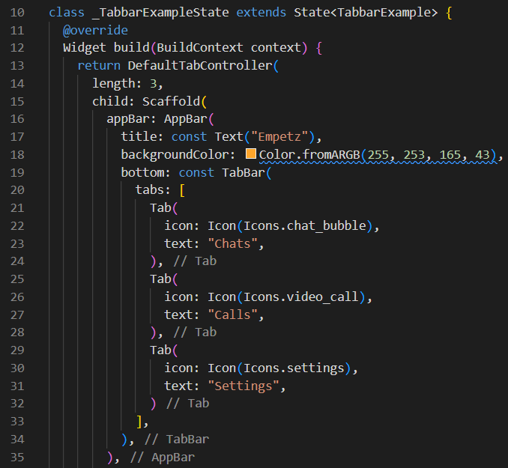
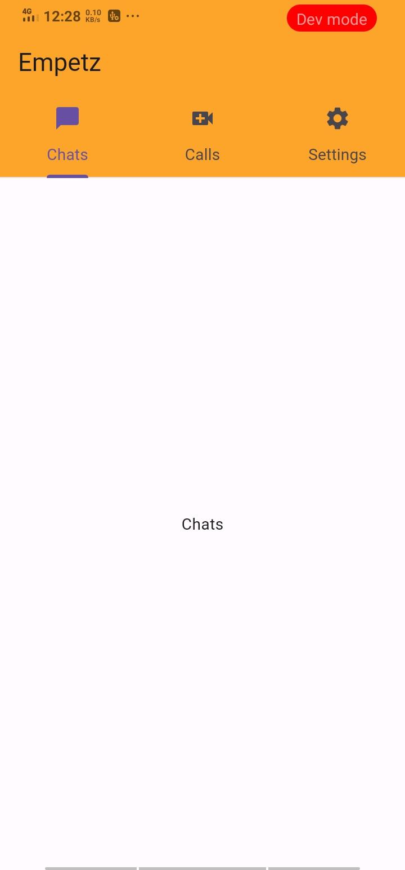
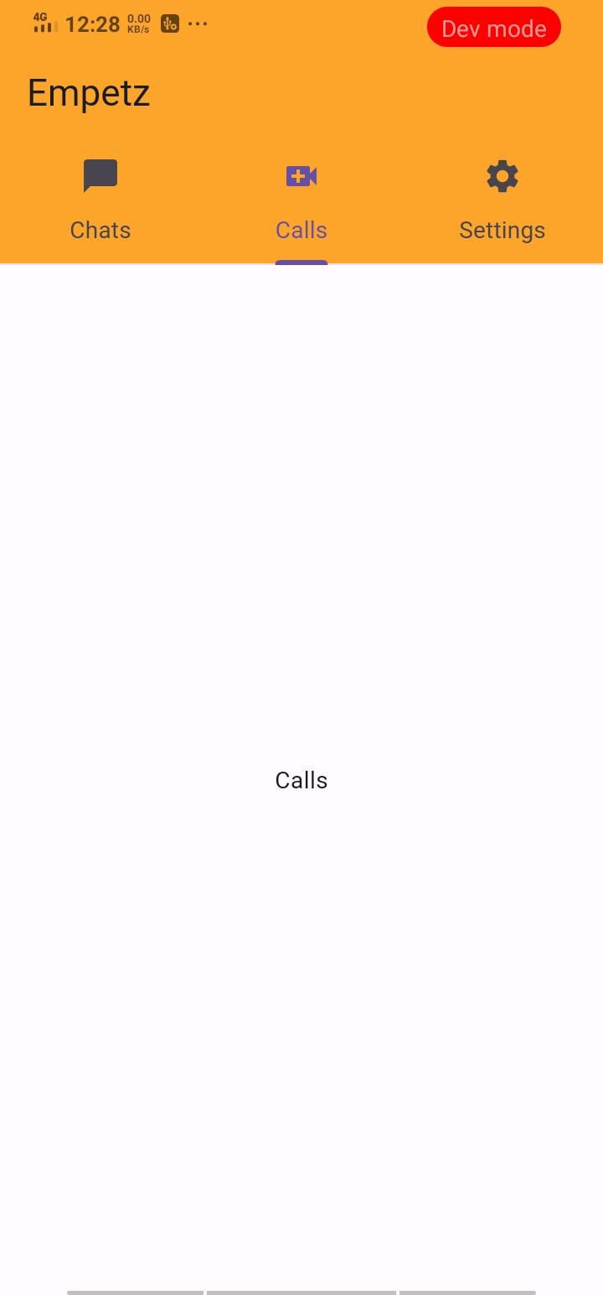
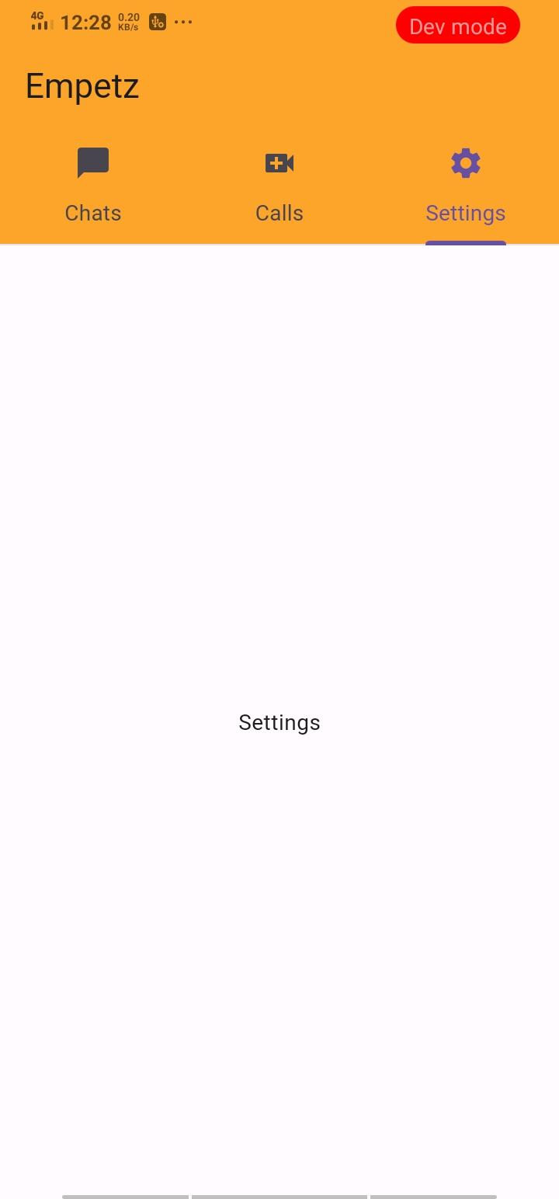
Example of Tab bar
Output​

Slide 10
Navigation Drawer
The navigation drawer in Flutter allows users to navigate to different pages of your app.
The navigation drawer is added using the Drawer widget.​
It can be opened via swipe gesture or by clicking on the menu icon in the app bar.​
The navigation drawer can be used as an alternate option to the TabBar widget.​
It is recommended to use a navigation drawer when you have at least five pages to navigate.​
Notes:
The navigation drawer in Flutter allows users to navigate to different pages of your app.
The navigation drawer is added using the Drawer widget.​
It can be opened via swipe gesture or by clicking on the menu icon in the app bar.​
The navigation drawer can be used as an alternate option to the TabBar widget.​
It is recommended to use a navigation drawer when you have at least five pages to navigate.​

Slide 11
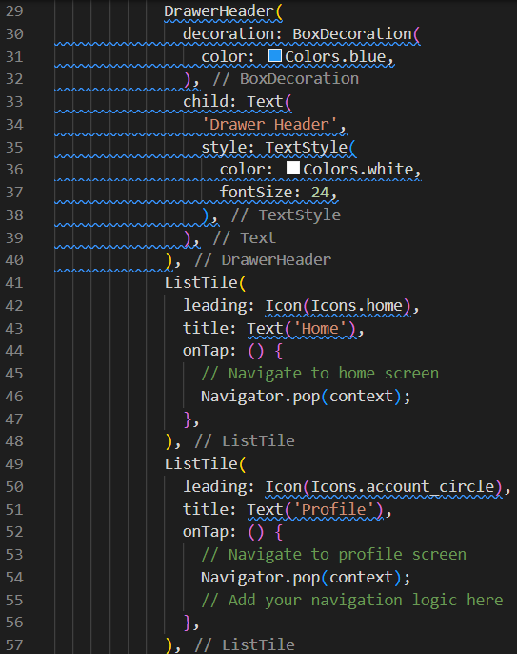
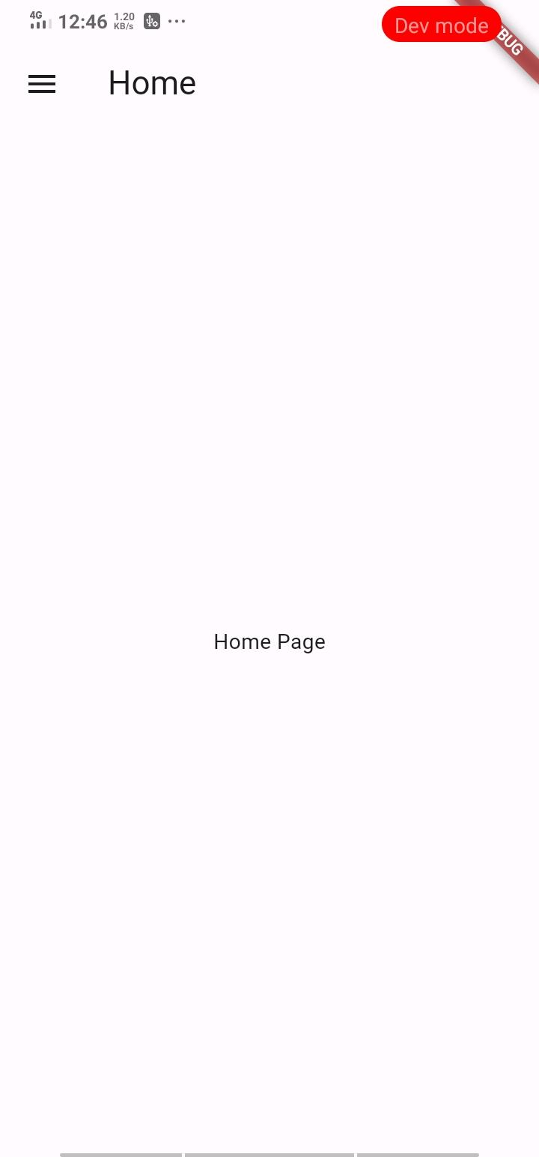
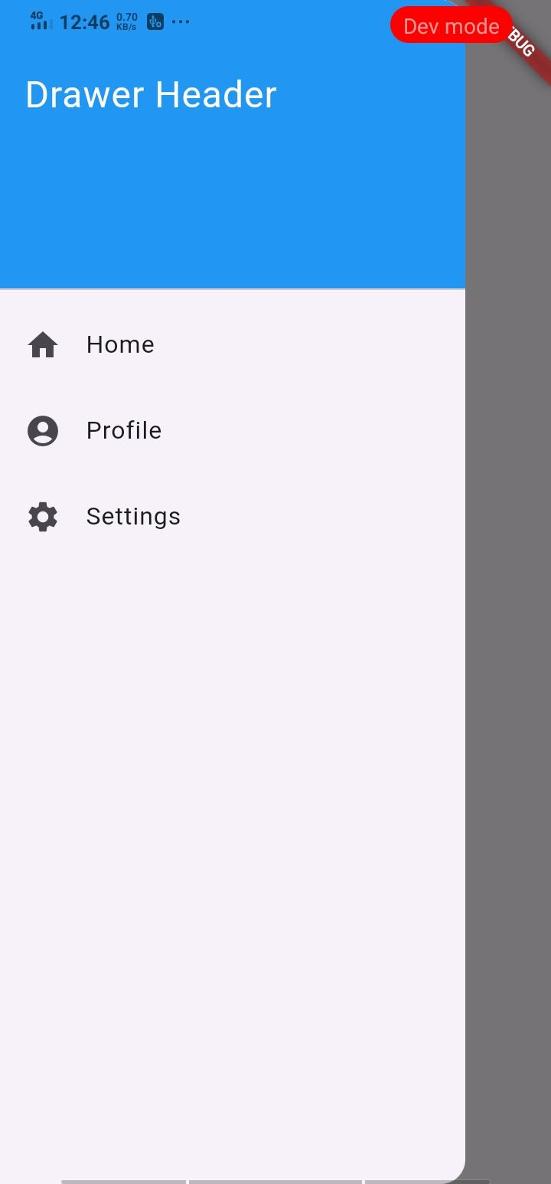
Example of Navigation Drawer
Output:

Slide 12
Bottom Sheet
A bottom sheet is a UI component that slides up from the bottom of the screen to display additional content or options. ​
It’s commonly used to present contextual actions, settings, or supplementary information without obstructing the main content of your app. ​
Flutter’s Bottom sheet widget makes it easy to implement this interaction pattern.​
Notes:
A bottom sheet is a UI component that slides up from the bottom of the screen to display additional content or options. ​
It’s commonly used to present contextual actions, settings, or supplementary information without obstructing the main content of your app. ​
Flutter’s Bottom sheet widget makes it easy to implement this interaction pattern.​

Slide 13

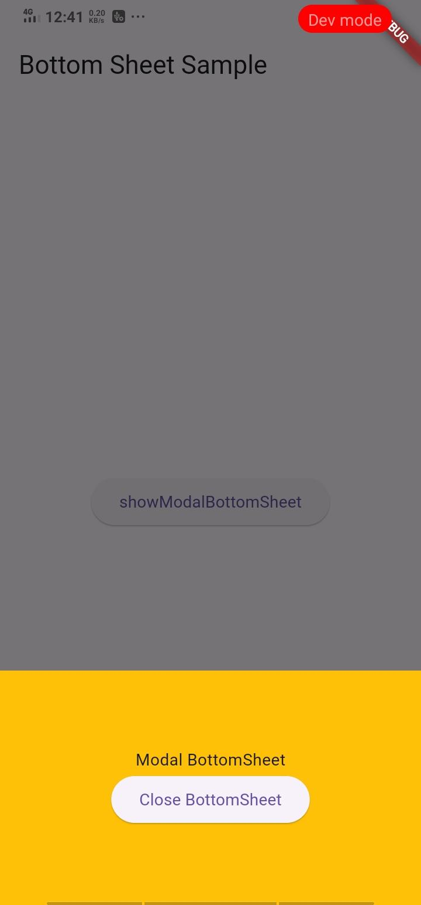
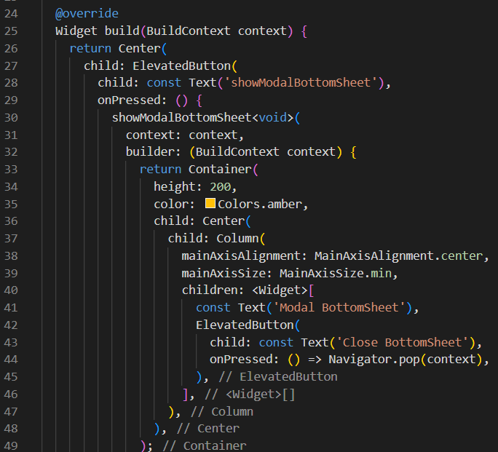
Example of Bottom Sheet
Output:​

Slide 14
Custom Widgets
In Flutter, a custom widget is a user-defined component that encapsulates a specific UI element or functionality. ​
They serve as the building blocks of your application, ensuring code reusability, maintainability, and a consistent design language.​
Essentially, you create a custom widget when:​
You need a UI element that doesn't exist as a built-in widget in Flutter.​
You want to reuse the same UI element with different configurations or data throughout your app.​
You desire unique functionality or a customized look and feel for specific UI elements.​
Notes:
Cutom Widgets
In Flutter, a custom widget is a user-defined component that encapsulates a specific UI element or functionality. ​
They serve as the building blocks of your application, ensuring code reusability, maintainability, and a consistent design language.​
Benefits of using custom widgets:
Code reusability: Reduce code duplication by creating a single widget that can be used multiple times.
Maintainability: Easier to update and maintain your UI if changes are needed in a single location (the custom widget).
Consistency: Enforce a consistent design language throughout your app by controlling the look and feel of each element through custom widgets.
Modularity: Break down your UI into smaller, independent components, making it easier to understand and manage.
Flexibility: Customize the behavior and appearance of your UI elements to meet your specific needs.
What defines a custom widget:
Dart file: Custom widgets are typically defined in separate Dart files, allowing for better organization and maintainability.
Constructor: This defines the parameters (inputs) your widget requires to function.
Build method: This method describes how the widget's UI is constructed based on its parameters and state.
State management: Some custom widgets may need to manage their own internal state, making them more complex.

Slide 15
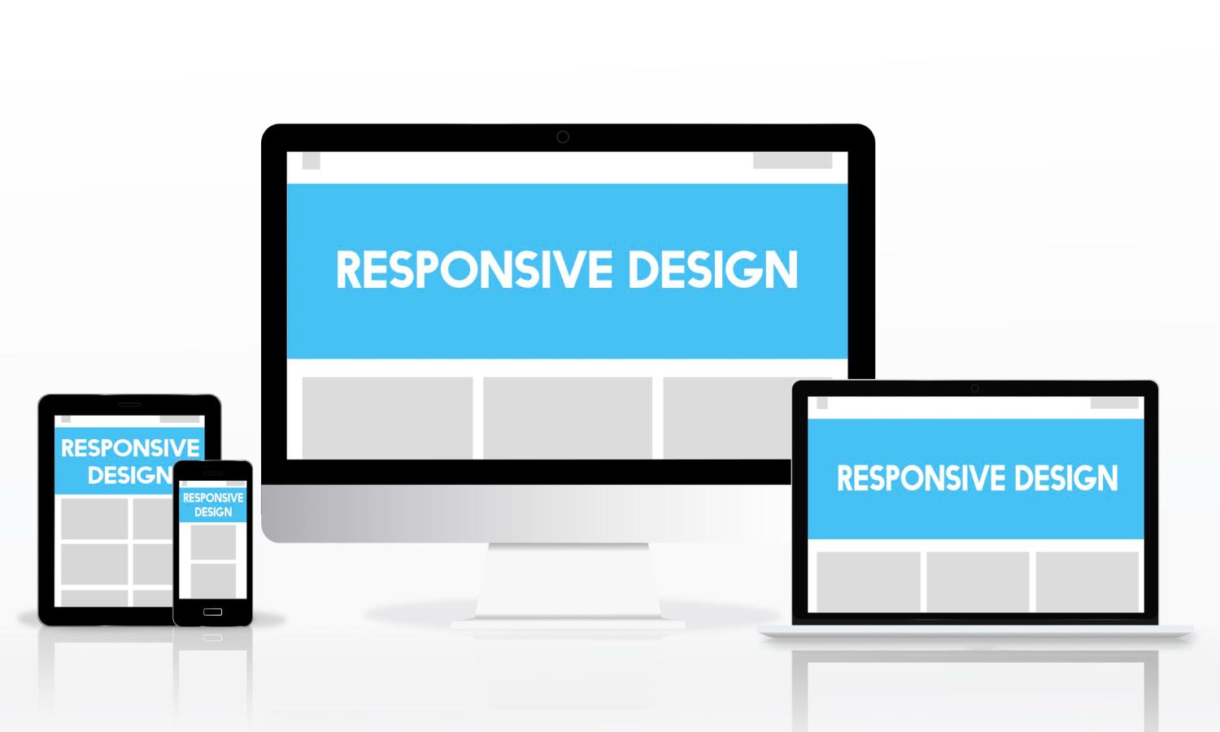
Complex Layouts and Responsive Design
Designing Effective Layouts for Various Screen Sizes​ ​
Mastering Layout Managers and Techniques​
​
Implementing Responsive Design Principles​
Notes:
Designing Effective Layouts for Various Screen Sizes: Crafting layouts that adapt seamlessly to different devices and screen orientations, ensuring optimal user experience
Mastering Layout Managers and Techniques: Employing layout managers and techniques to achieve organized and structured UI layouts, catering to different user interactions
Implementing Responsive Design Principles: Embracing responsive design principles to dynamically adjust UI layouts based on screen size, ensuring consistent user experience across devices

Slide 16
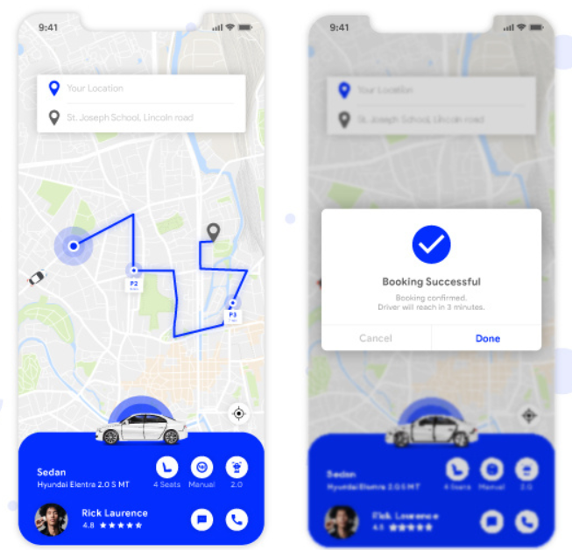
Example: UI Design of an Taxi-Booking Application

Slide 17
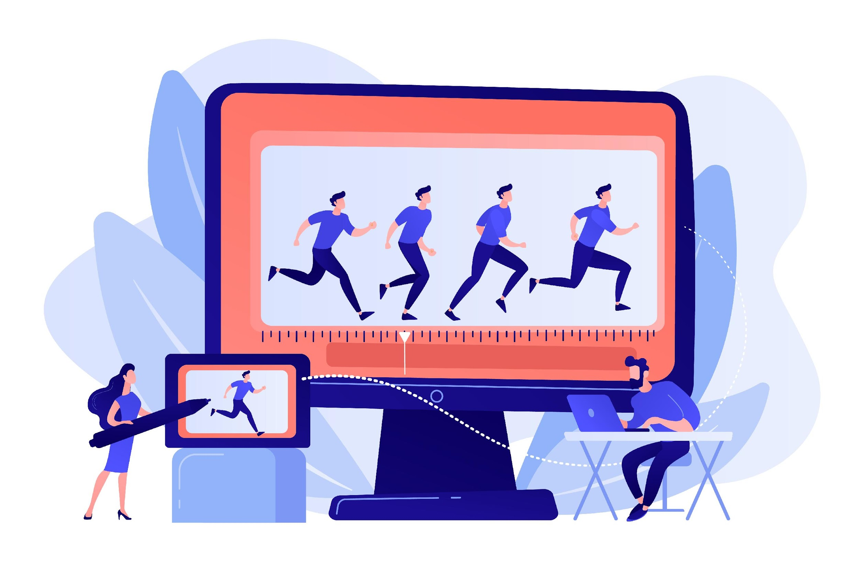
Advanced Animations and Motion Design
Incorporating Advanced Animation Techniques ​
Utilizing Motion Design Principles​
Employing Animation Libraries and Frameworks ​
Notes:
Incorporating Advanced Animation Techniques: Enhancing UI interactivity and engagement through advanced animation techniques, such as physics-based animations and transitions
Utilizing Motion Design Principles: Applying motion design principles to create visually appealing and intuitive user experiences, guiding users through interactions
Employing Animation Libraries and Frameworks: Leveraging animation libraries and frameworks to simplify animation implementation, streamline workflows, and access a range of animation effects

Slide 18
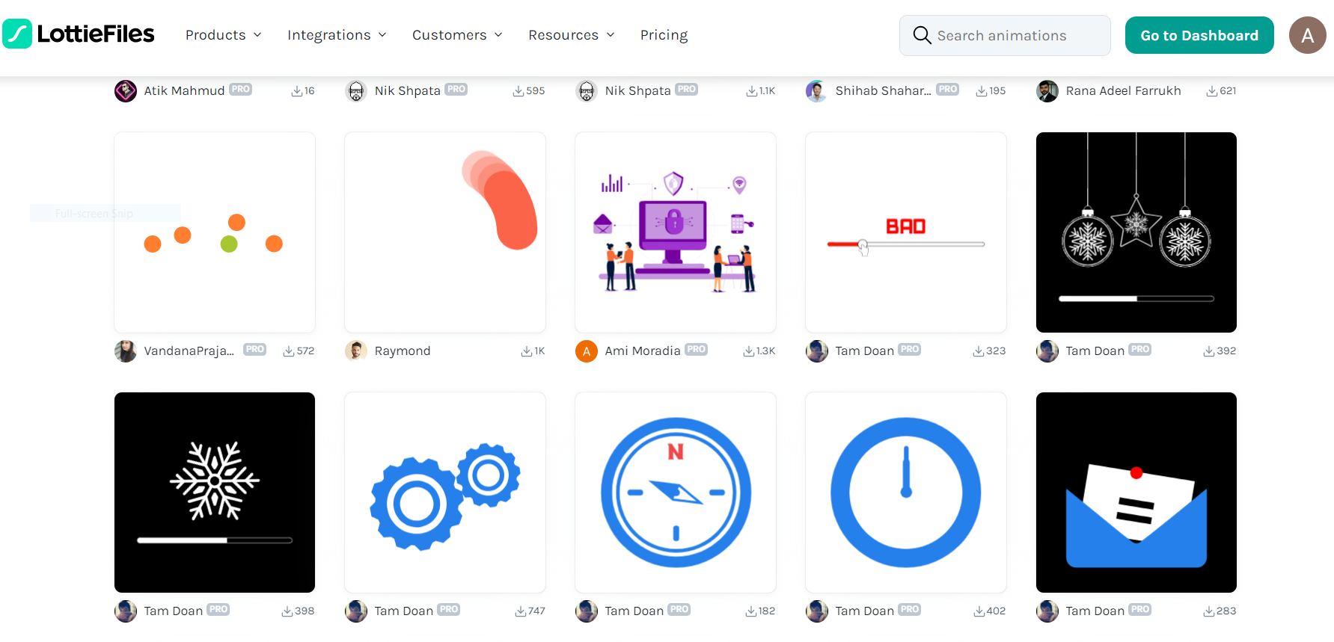
Example: Lottie file Animation

Slide 19
Animations:

Slide 20

State Management at Scale
Effectively Managing UI State in Large-Scale Applications​​
​​
Utilizing State Management Libraries and Frameworks ​​ ​​
Addressing State Complexity and Performance Challenges​​
Notes:
Effectively Managing UI State in Large-Scale Applications: Addressing the complexities of state management in large applications, ensuring data consistency and synchronization across multiple UI components
Utilizing State Management Libraries and Frameworks: Employing state management libraries and frameworks to streamline state management, implement state change notifications, and handle complexity efficiently
Addressing State Complexity and Performance Challenges: Implementing strategies to optimize state management performance, minimize performance bottlenecks, and handle large amounts of data

Slide 21

Integrating UI with Backend Services
Connecting UI Components with Backend Services​
​
Implementing Data Fetching and Caching Strategies​
​
Handling Network Requests and Error Scenarios Gracefully​
Notes:
Connecting UI Components with Backend Services: Establishing seamless communication between UI components and backend services, enabling data retrieval and manipulation
Implementing Data Fetching and Caching Strategies: Optimizing data fetching strategies to minimize network requests and improve performance, utilizing caching mechanisms for efficient data retrieval
Handling Network Requests and Error Scenarios Gracefully: Implementing robust error handling mechanisms to gracefully handle network errors and provide informative feedback to users

Slide 22

Conclusion
Recap of Key Takeaways​​
​
​​
Emphasis on Mastering Advanced UI Development Techniques​​
​​ ​​
Encouragement for Continuous Learning and Experimentation​​
Notes:
Recap of Key Takeaways: Summarizing the essential concepts and techniques covered in the presentation
Emphasis on Mastering Advanced UI Development Techniques: Reinforcing the importance of mastering advanced UI development techniques to create exceptional user experiences
Encouragement for Continuous Learning and Experimentation: Fostering a culture of continuous learning and experimentation to stay at the forefront of UI development

